Slide 1
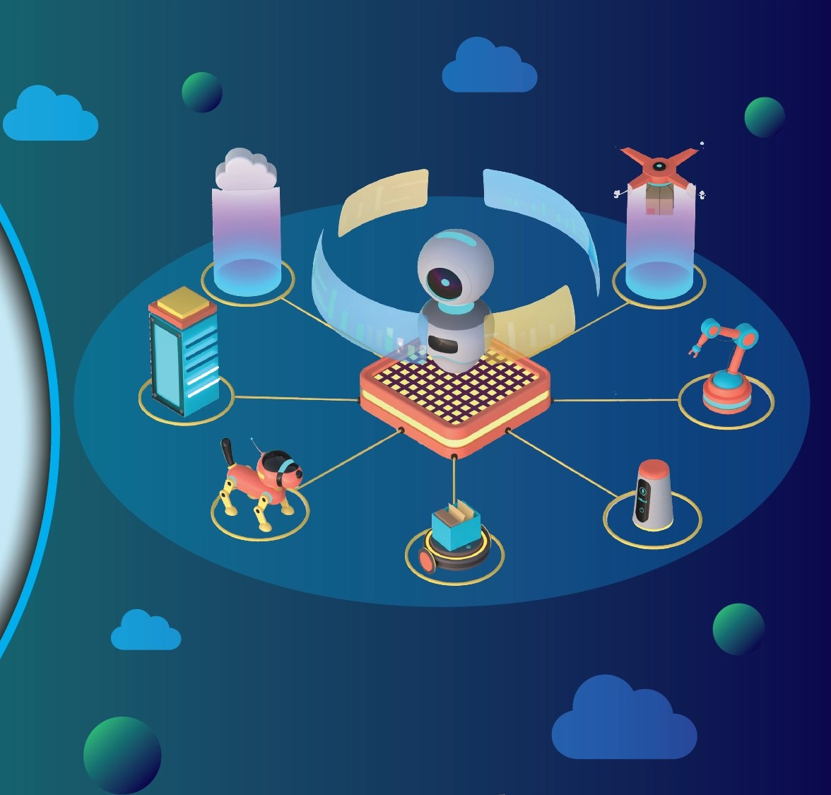
LLM PROJECT ON BUILDING A NEWS RESEARCH TOOL
NAME: S. SUJANA KUMARI AFFILIATION: DIGICROME ACADEMY

Slide 2
PROJECT OVERVIEW
Objective:
Build an AI-powered tool for summarizing news articles
Technologies:
LangChain, OpenAI API, Streamlit, NewsAPI
Features:
Query-based summarization, UI for interaction, export options

Slide 3
Phase 1: Environment Setup
INSTALL REQUIRED LIBRARIES: pip install langchain openai streamlit newsapi-python
from dotenv import load_dotenv
import os
from newsapi import NewsApiClient
from langchain_groq import ChatGroq
from langchain_core.prompts import PromptTemplate
import streamlit as st
from langchain_config import get_summary
OBTAIN API KEYS: - OpenAI API Key
NewsAPI Key

Slide 4
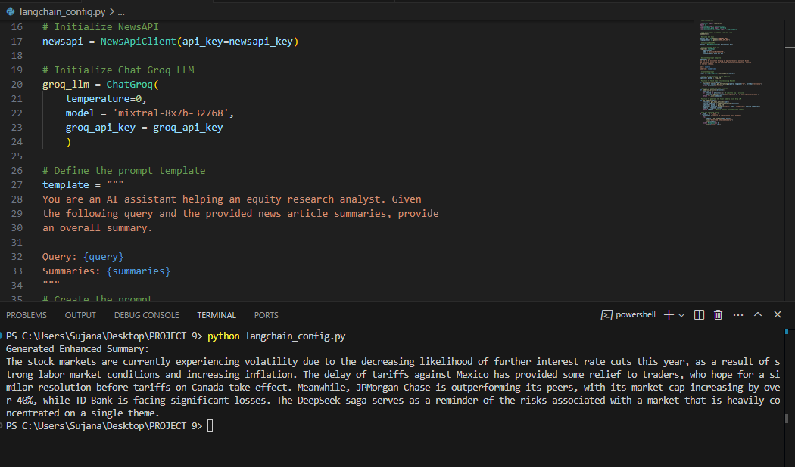
Phase 2: LangChain Configuration
Create langchain_config.py
• Initialize OpenAI API with LangChain
• Define prompt template for news summarization
This is the screenshot of file langchain_config.py

Slide 5
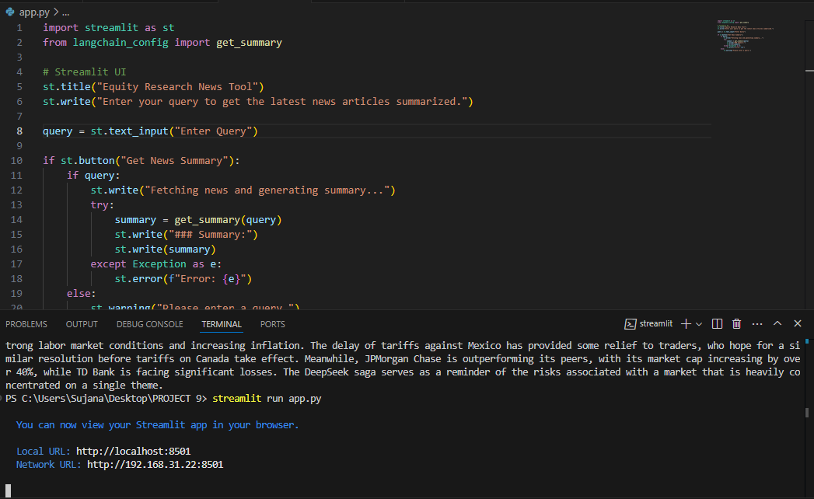
Phase 3: Building Streamlit Interface
Create app.py
• Implement basic Streamlit UI for querying
• Run the app using: streamlit run app.py
Below is the screenshot of the same
Business or Analytical Implications:
Majority of Workforce Earns Low Wages: Policies or skill improvement programs could focus on helping workers move into higher-paying jobs.
High-Paying Jobs are Rare: Industries or roles that command high rates should be explored for better career recommendations.
Potential Salary Cap Considerations: Companies may need to re-evaluate pay structures to ensure fair distribution of wages.

Slide 6
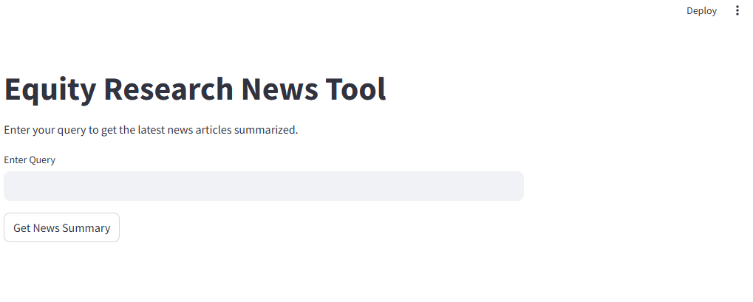
Phase 4: Testing and Validation
Test basic functionality: Ensure app runs and responds correctly
I

Slide 7
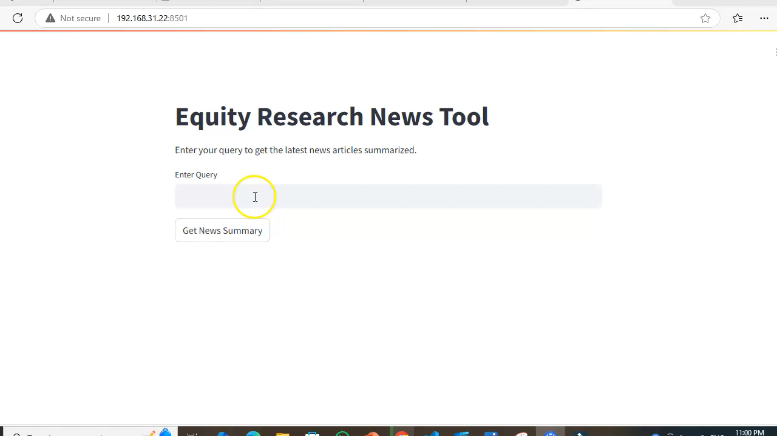
Phase 4: Testing and Validation
Here is a video of testing and validating the local host page.
I

Slide 8
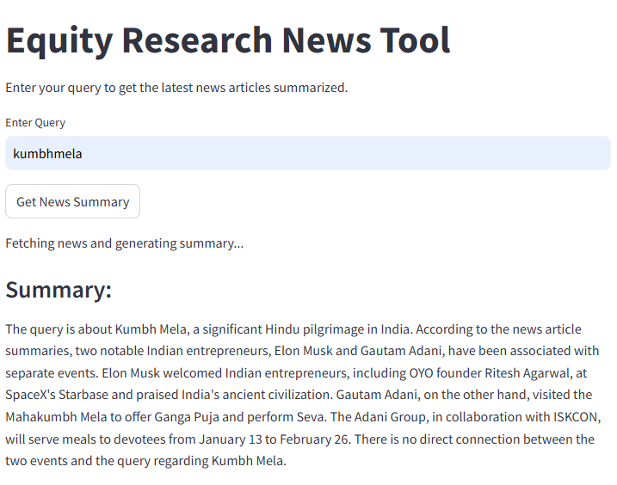
Phase 4: Testing and Validation
The screenshot below shows that the news summary displayed about the query entered is valid. Hence the validation is perfect.
I

Slide 9
THANK YOU

